Slide 1
Apache Flink
Pravin Y Pawar

Slide 2

Apache Flink
A framework and distributed processing engine for stateful computations over unbounded and bounded data streams
Designed to run in all common cluster environments, perform computations at in-memory speed and at any scale
Users reported impressive scalability numbers for Flink applications running in their production environments, such as
applications processing multiple trillions of events per day,
applications maintaining multiple terabytes of state, and
applications running on thousands of cores.

Slide 3
Apache Flink Application
Type of Flink Applications
The most common types of applications that are powered by Flink and give pointers to real-world examples are
Event-driven Applications
Data Analytics Applications
Data Pipeline Applications
Source : https://flink.apache.org/usecases.html

Slide 4
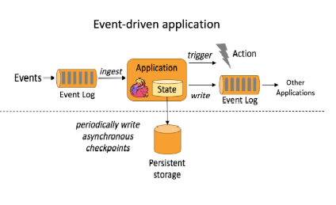
Event-driven Applications
Application is a stateful application that ingest events from one or more event streams and reacts to incoming events by triggering computations, state updates, or external actions.
Are based on stateful stream processing applications
Data and computation are co-located, which yields local (in-memory or disk) data access
Fault-tolerance is achieved by periodically writing checkpoints to a remote persistent storage

Slide 5
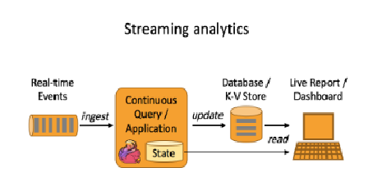
Data Analytics Applications
Analytical jobs extract information and insight from raw data
With a sophisticated stream processing engine, analytics can also be performed in a real-time fashion
Streaming queries or applications ingest real-time event streams and continuously produce and update results as events are consumed
The results are either written to an external database or maintained as internal state.
Dashboard application can read the latest results from the external database or directly query the internal state of the application.

Slide 6
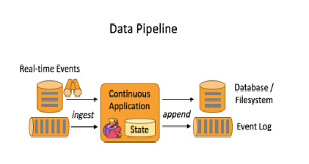
Data Pipeline Applications
Extract-transform-load (ETL) is a common approach to convert and move data between storage systems
Data pipelines
serve a similar purpose as ETL jobs
transform and enrich data and can move it from one storage system to another.
operate in a continuous streaming mode instead of being periodically triggered.
are able to read records from sources that continuously produce data and move it with low latency to their destination.
For example a data pipeline might monitor a file system directory for new files and write their data into an event log

Slide 7
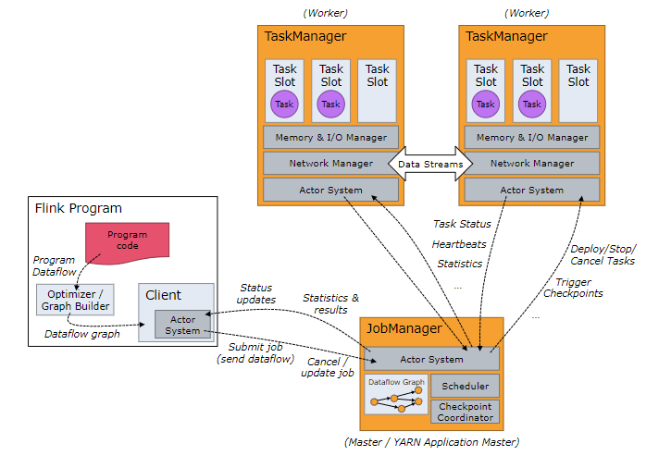
Flink Architecture
Source : https://ci.apache.org/projects/flink/flink-docs-master/concepts/runtime.html

Slide 8
Flink Architecture(2)
Processes
The JobManagers (also called masters)
coordinate the distributed execution
schedules tasks, coordinate checkpoints, coordinate recovery on failures, etc.
always at least one Job Manager
A high-availability setup will have multiple JobManagers, one of which one is always the leader, and the others are standby.
The TaskManagers (also called workers)
execute the tasks (or more specifically, the subtasks) of a dataflow, and buffer and exchange the data streams.
must always be at least one TaskManager
TaskManagers connect to JobManagers, announcing themselves as available, and are assigned work.
The client
not part of the runtime and program execution, but is used to prepare and send a dataflow to the JobManager
can disconnect, or stay connected to receive progress reports after program is submitted for execution
runs either as part of the Java/Scala program that triggers the execution, or in the command line process

Slide 9
Thank You!
In our next session: Apache Samza

